Slide 1

Exploratory Data Analysis On AMEO Dataset
Vishakha Deshmukh IN1240031
22 February 2024

Slide 2
About me
Greetings! I'm Vishakha Deshmukh,a currently pursuing a Master's of Science in Information Technology. Have a keen interest in data science field.
Currently working as Data Science Intern at Innomatics Research Lab.
Linkedin

Slide 3
1.Objective Of This Project:
This analysis aims to gain a valuable insights from the provided dataset focusing on relationship between various feature and keeping the Salary as a target variable.
The primary Goal is to:
Gain a deep understanding of the structure and content of the AMEO dataset.
Uncover patterns and trends in the data through univariate and bivariate analyses.
Examine Relationships between variables
The analysis is to explore the factors influencing salary outcomes among engineering graduates
2.Data Description:
The dataset was released by Aspiring Minds from the Aspiring Mind Employment Outcome 2015 (AMEO). The study is primarily limited only to students with engineering disciplines. The dataset contains the employment outcomes of engineering graduates as dependent variables (Salary, Job Titles, and Job Locations) along with the standardized scores from three different areas – cognitive skills, technical skills and personality skills.
The dataset also contains demographic features.The dataset contains around 40 independent variables and 4000 data points. Contains 3998 rows and 39 columns.

Slide 4
3.Data Cleaning Steps:
1.Conversions of Data Types:
Date of Joining , Data of Leaving and Date Of Birth are been converted into datetime format .
Replaced the “Present” values in this fields with current date .
It ensures that the date values are interpreted correctly
2.Validated the O or -1 values :
There were no null values present in the dataset but 0 and -1 will represents that subjects were not pursed.

Slide 5
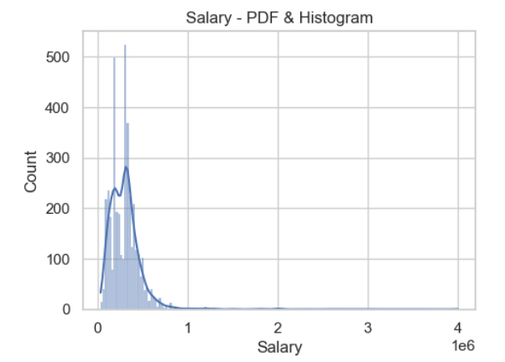
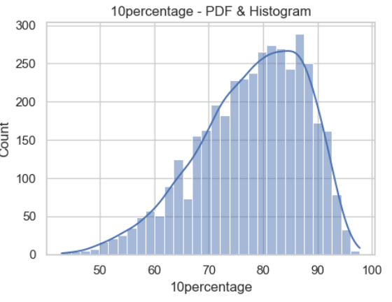
4.Exploratory Data Analysis 1.Univariate Analysis Numerical Features:
Distribution of salary:
A positively skewed distribution indicate that a majority of graduates earn salaries below the mean
10 Percentage:
The histogram shows that majority of students have scored between 75% to 90%
Add most highest percentage is around 90 . Approximately most of students have scored 81% or lower

Slide 6
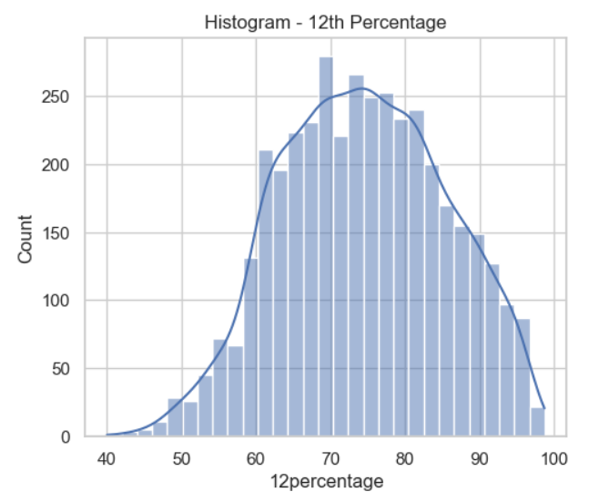
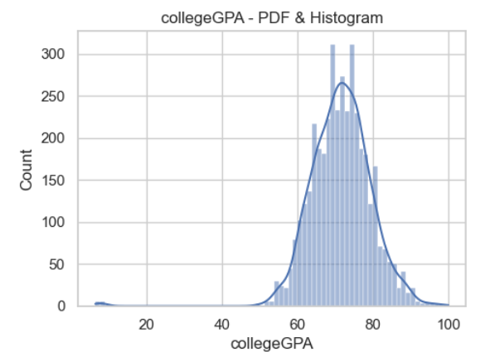
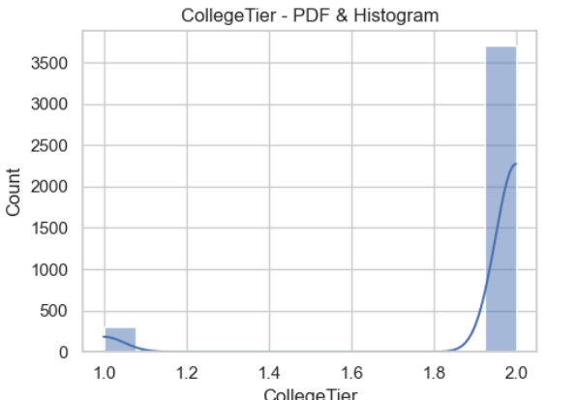
12 percentage
Majority of students scored between 65% to 85%
Highest percentage scored is 70
College Tier
Around almost students are more tier 2 college and very few from tier 1
College GPA
Most of the students have GPA between 63% to 78%. Majority of students have GPA 80% or lower.

Slide 7
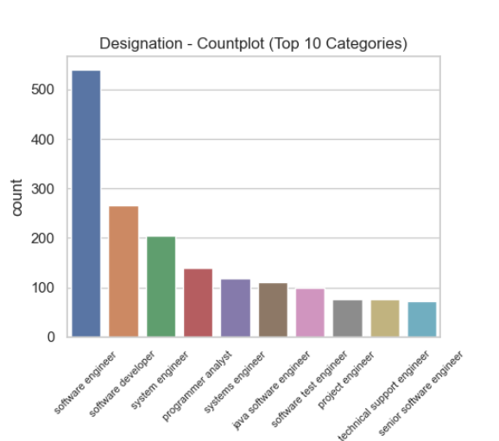
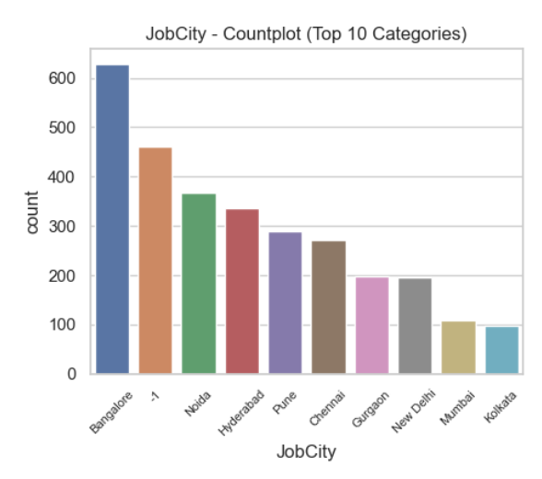
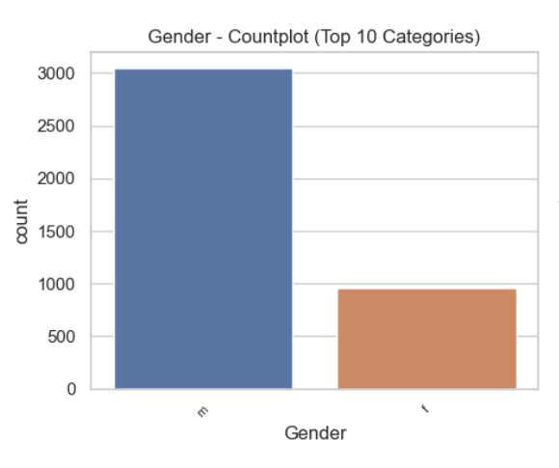
Categorical Features
Displayed the Top 10 categories from the categorical columns
Designation
Software Engineeer is the most prevalent designation followed by software developer,system engineer and other categories are also present.
JobCity
Bangalore appears to the most preferrable city for job followed by Noida,Hyderabad ,pune while Mumbai and Kolkata are less prefferable
Gender
Male Students are more than Female ones.

Slide 8
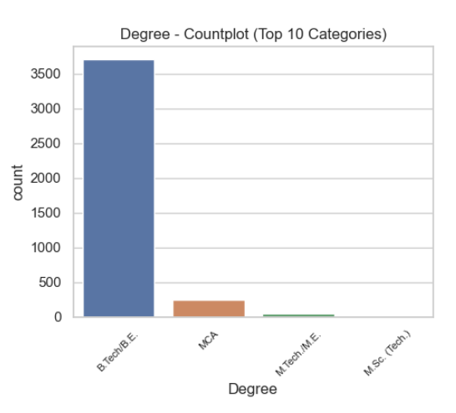
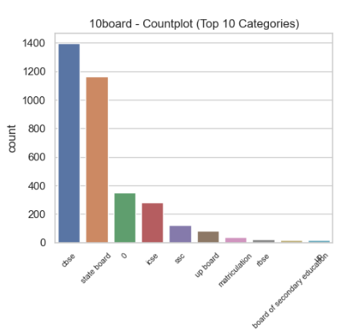
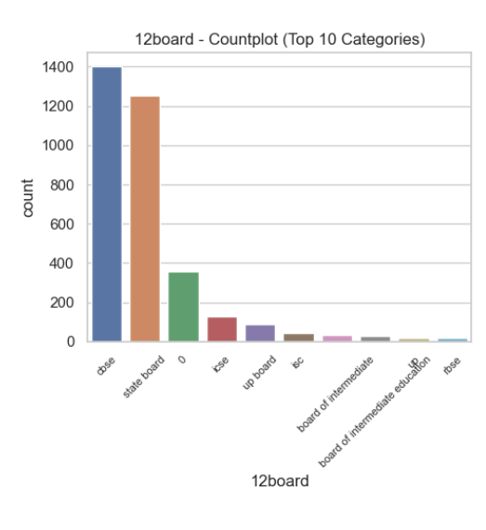
Degree
Most of the students have pursed the B.Tech/B.E Degree.
10 Board and 12 Board
CBSE emerges has the most common School board for about 10 and 12 grade.

Slide 9
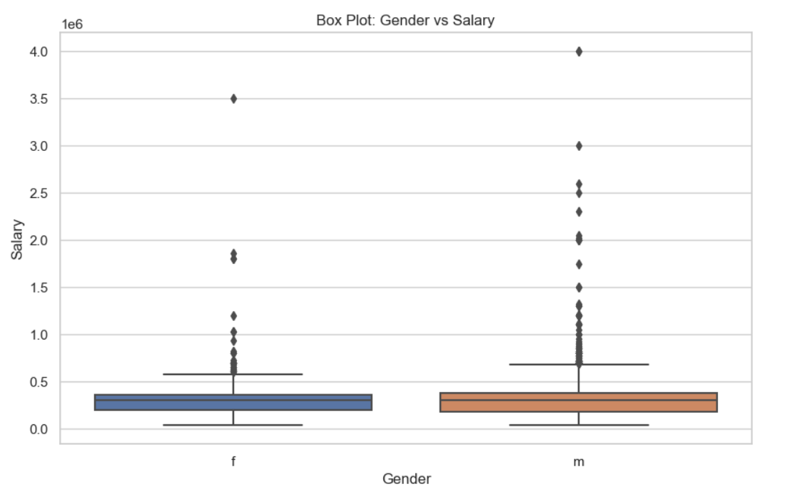
2.Bivariate Analysis
1.Gender and Salary
Both male and female salary are approximately equal. But the male slightly receives above average then female
By Descriptive Satistics-
On average, male individuals tend to have a slightly higher mean salary ($311,716) compared to female individuals ($294,937).

Slide 10
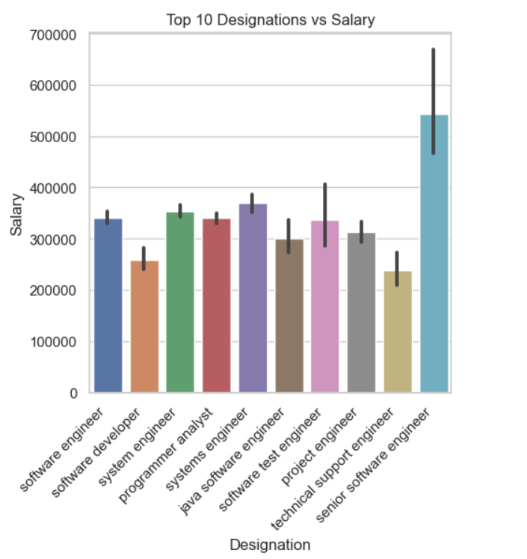
2.Salary and Designation
Senior Software Engineer have highest salary and software developer and software engineer have below average. The mean salaries vary across different designations.

Slide 11
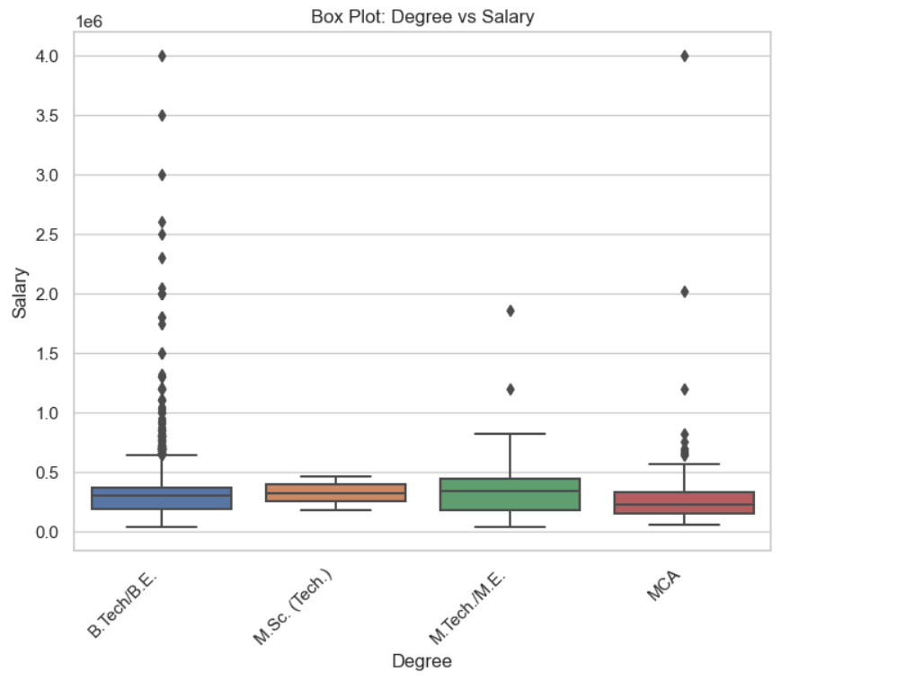
3.Degree and Salary
A B.Tech/B.E student have highest salary and the MCA student also been paid more .The data suggests that advanced technical degrees such as M.Tech./M.E. tend to have higher mean salaries.
.B.Tech/B.E. and M.Sc. (Tech.) degrees fall in the middle range.
MCA degrees, on average, have a slightly lower mean salary.

Slide 12
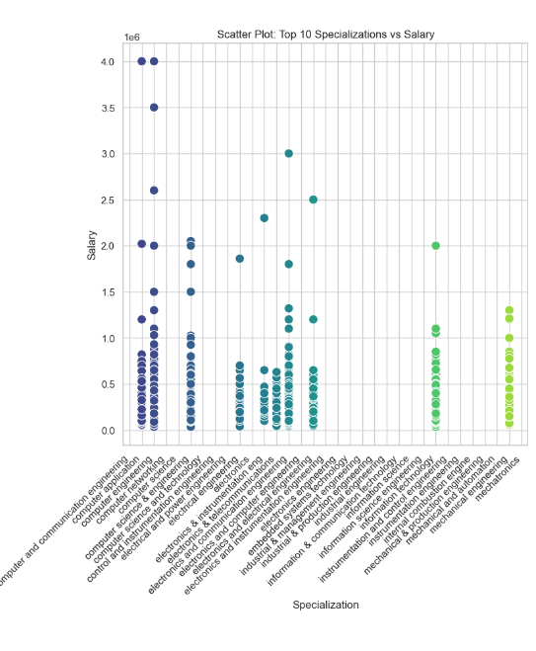
4.Specialization and Salary
Mean salaries vary widely across different specializations and genders.
Some specializations have higher mean salaries for a particular gender, while others may have no information or a lower mean salary.

Slide 13
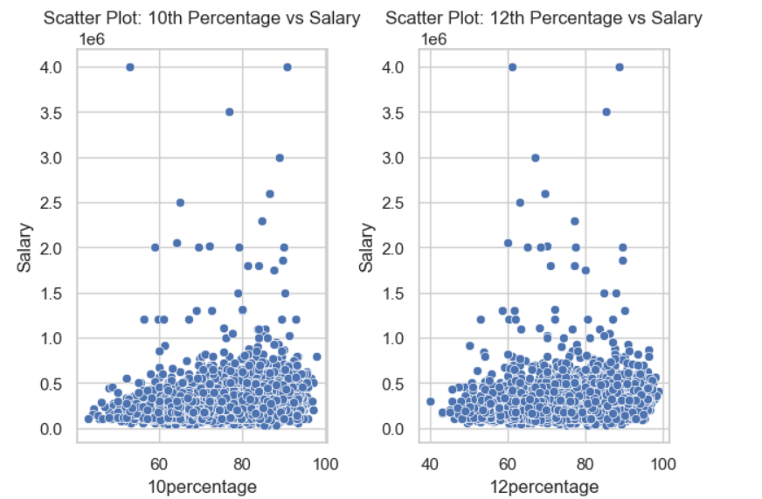
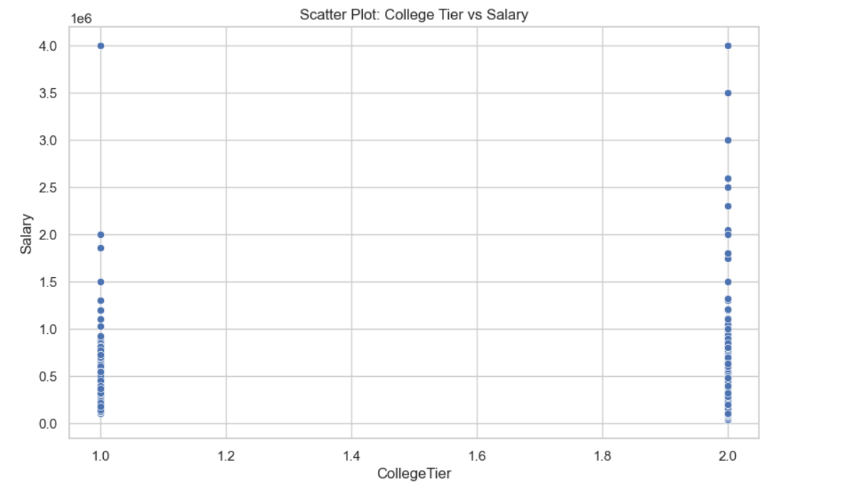
5.Academic Performance and Salary
1.There is not a significant correlation between academic scores and salary.
2.There is a weak positive correlation between academic scores and salary. However, the correlation is not strong, indicating that academic scores alone may not be highly predictive of salary levels.
6.College Tier and Salary
Tier 1 college offer more salary compared to tier 2.

Slide 14
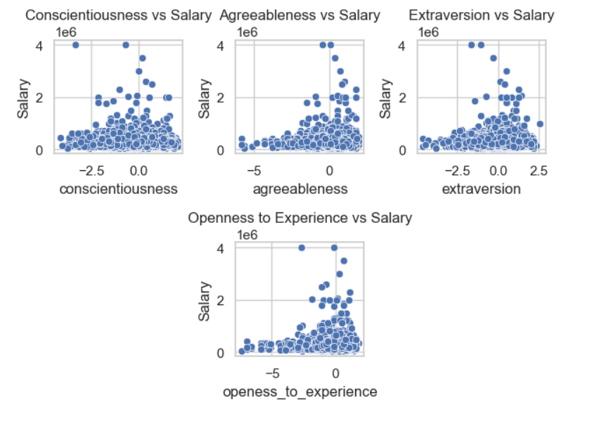
7.Personality Traits and Salary
The correlations between personality traits and salary are generally weak, indicating that personality traits alone may not be strong predictors of salary.
It's crucial to consider other factors and individual circumstances that contribute to salary variations

Slide 15

Research Outcome
Times of India article dated Jan 18, 2019 states that “After doing your Computer Science Engineering if you take up jobs as a Programming Analyst, Software Engineer, Hardware Engineer and Associate Engineer you can earn up to 2.5-3 lakhs as a fresh graduate.
A sample t-test is conducted for each designation to compare acerage salary against expected range. Programmer Analyst Software Engineer ,test shows the evidence to reject the hypothesis and Hardware Engineers and Associate Engineers fails to reject the hypothesis
Is there a relationship between gender and specialization? (i.e. Does the preference of Specialisation depend on the Gender?)
Analyzed by Chi-square test for examining the relationship between gender and specialization . The Result is that they both have a significant relationship. The critical value is less than significance level which is equal to 0.5
The p-value is very close to zero, which is typically considered statistically significant. Therefore, we reject the null hypothesis and conclude that there is a significant relationship between gender and specialization.

Slide 16
Conclusion:
In conclusion, the exploratory data analysis (EDA) conducted on the dataset provided valuable insights into the employment outcomes of engineering graduates from the Aspiring Mind Employment Outcome 2015 (AMEO).
Salary distribution varies widely among engineering roles, with outliers observed.
No significant dependence between gender and specialization was observed
Significant differences in salary based on college tier were observed.
Gender does not impact determining the income,yet female earns slightly less than male.
Academic performance, 10th,12th and College GPA score does not correlate with salary levels.

Slide 17

THANK YOU

